Slide 1
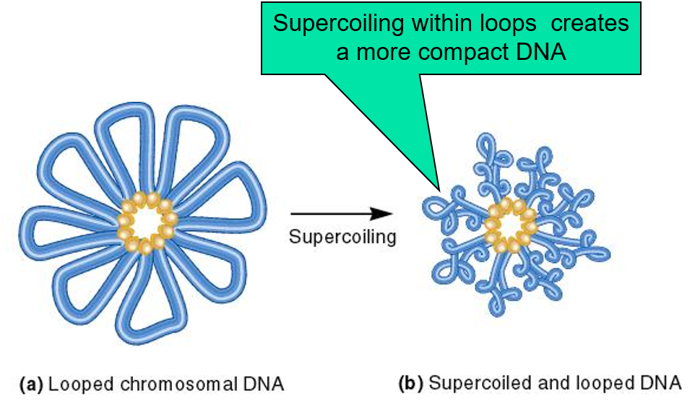
DNA looping and supercoiling
To fit within the bacterial cell, the chromosomal DNA must be compacted about a 1000-fold
https://www.youtube.com/watch?app=desktop&v=30B0wGAID4o

Slide 2
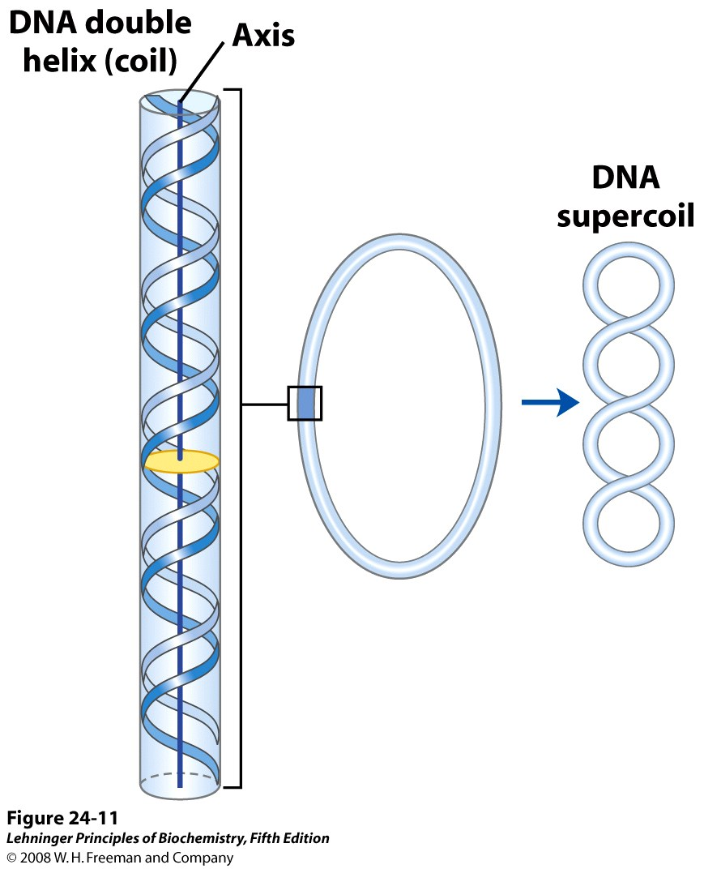
DNA supercoiling
When the axis of the DNA double helix is coiled on itself, it forms a new helix (superhelix).
The DNA superhelix is usually called a supercoil.
When there is no net bending of the DNA axis upon itself, the DNA is said to be in a relaxed state (i.e. one turn of the double helix per 10.5 bp).
Supercoiling results when DNA is subject to some form of structural strain.
Purified closed-circular DNA is rarely relaxed, regardless of its biological origin.

Slide 3
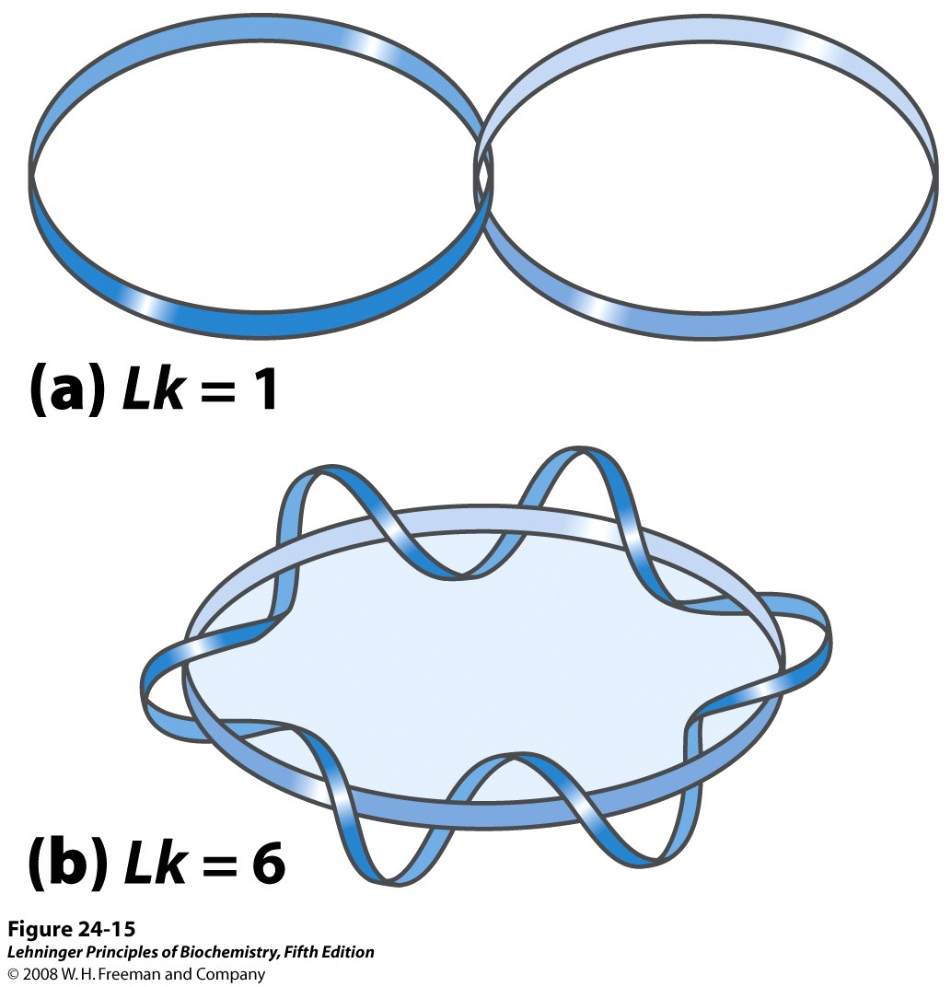
What induces DNA supercoiling?
DNA topology/Linking number
Positive supercoiling is the left-handed, coiling of DNA
Negative supercoiling is the right-handed coiling of DNA,
Linking number is a measure of the total number of complete revolutions that either strand makes about the other
Linking Number Is an invariant Topological Property of Covalently Closed, Circular DNA
Notes:
Lk is a measure of the total number of complete revolutions that either strand makes about the other

Slide 4
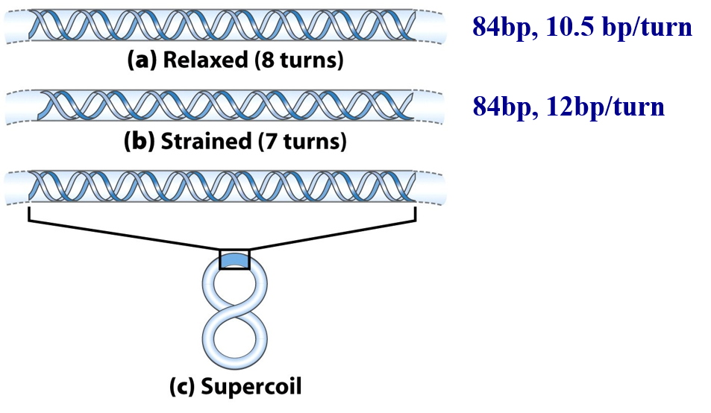
Effect of DNA underwinding

Slide 5
Prokaryotic topoisomerases
Enzymes that participate in the overwinding or underwinding of DNA

Slide 7
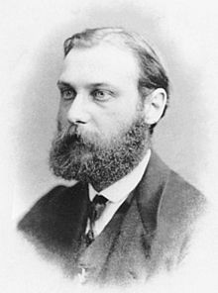
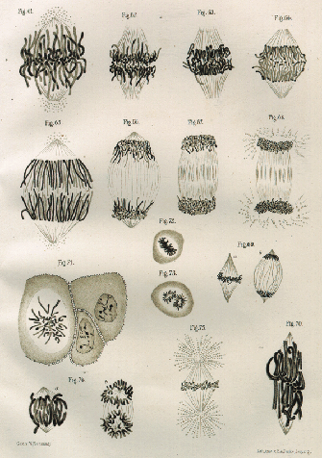
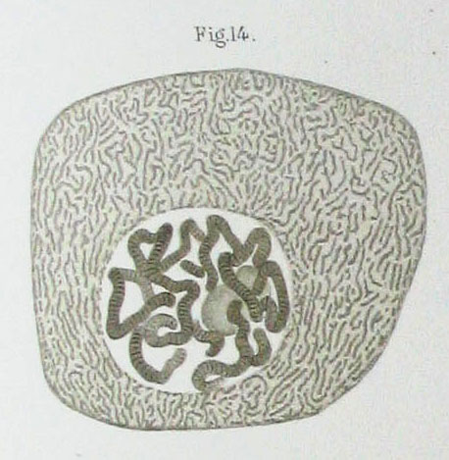
Chromosome discovery
Walther Flemming first recognized and explored the fibrous network within the nucleus, which he termed chromatin, or "stainable material."
Drawing of polytene chromosomes in salivary gland cell, Walther Flemming, 1885
Drawing of mitosis by Walther Flemming, 1882
Notes:
Walther Flemming (21 April 1843 – 4 August 1905) was a German biologist and a founder of cytogenetics.

Slide 8
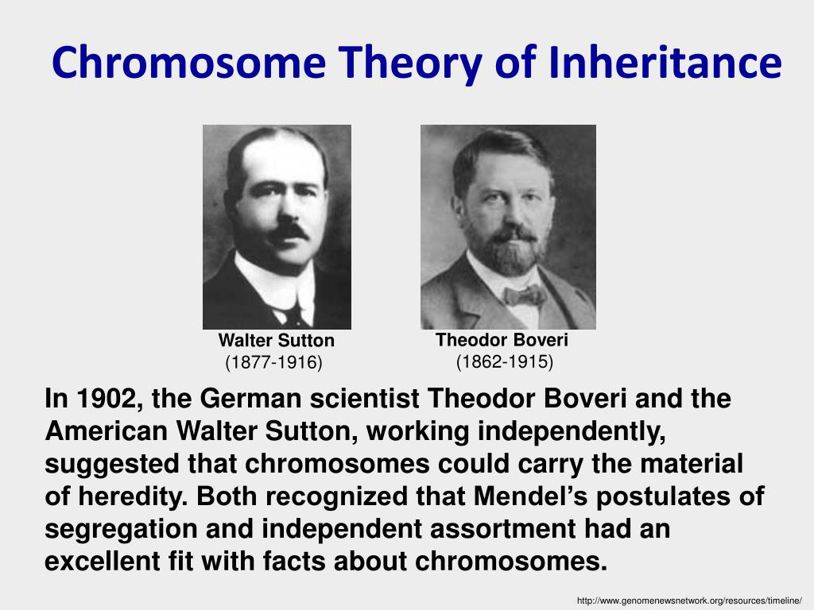
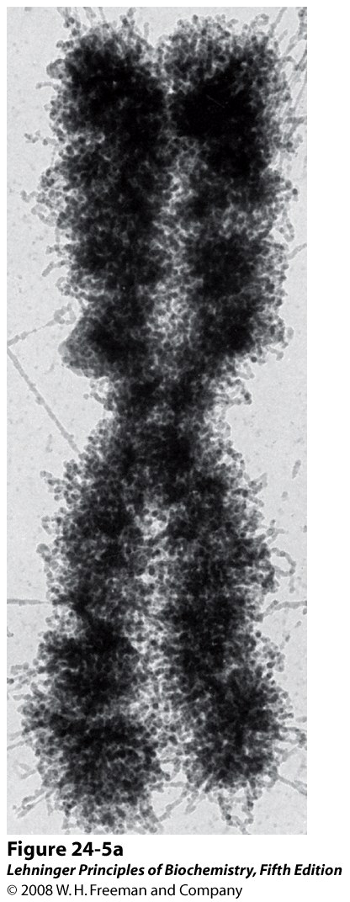
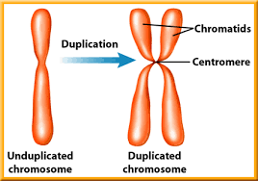
Notes:
Boveri was studying sea urchins, in which he found that all the chromosomes had to be present for proper embryonic development to take place. Sutton's work with grasshoppers showed that chromosomes occur in matched pairs of maternal and paternal chromosomes which separate during meiosis and "may constitute the physical basis of the Mendelian law of heredity"

Slide 9
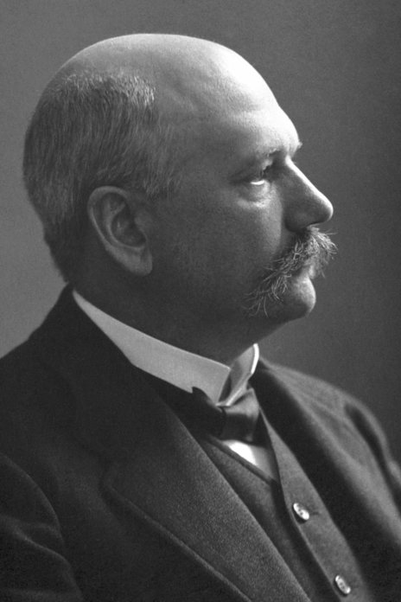
Albrecht Kossel
The Nobel Prize in Physiology or Medicine 1910
The Chemical Composition of nucleic acid
“Chemical analysis showed first that in many cases nucleic substances are broken down into two parts, one having the character of a protein. This part possesses no other atom groups than the usual proteins. The other part, however, is of characteristic structure; it has been given the name of “nucleic acid“. From it I succeeded in obtaining a number of fragments which could be dissolved out of the molecule in part even by gentle chemical action and which were recognizable by a quite special concentration of nitrogen atoms. Here four nitrogen-containing groups are present together: cytosine, thymine, adenine, guanine.
A protein of this kind is found for example in the nuclei of birds’ erythro-cytes and as I have already mentioned may be easily removed by dilute mineral acids. It is called “histone”. Similar substances are widely distributed in the tissues of higher and lower animals in a salt-like combination with nucleic acid.”

Slide 10
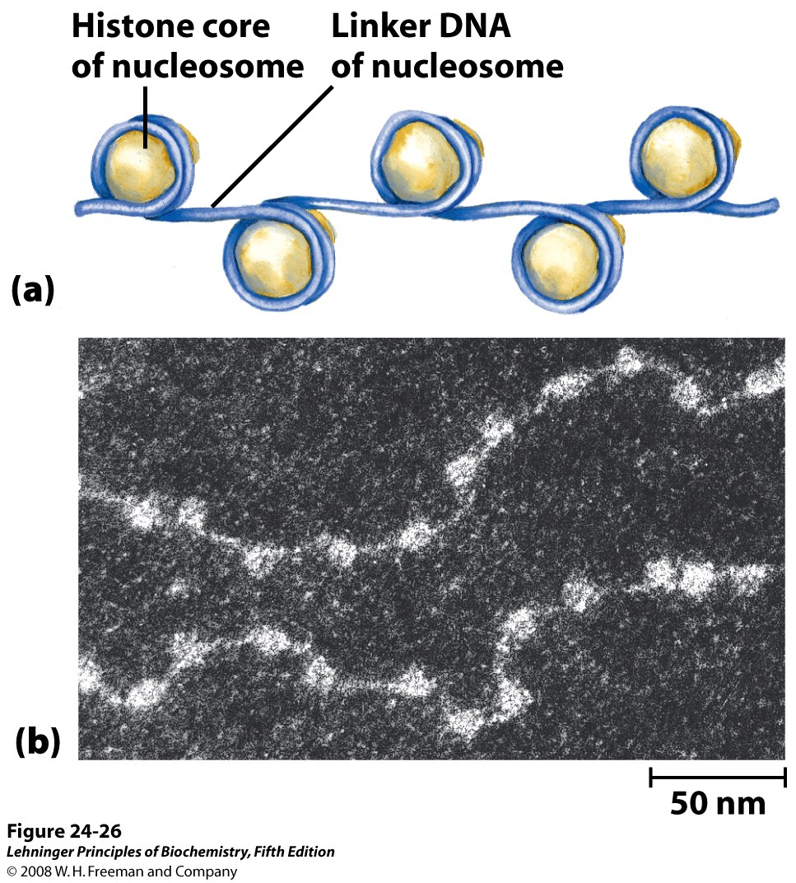
Nucleosomes: structural unit of chromosome

Slide 11
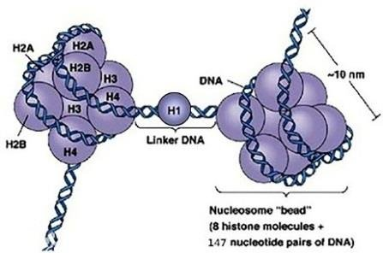
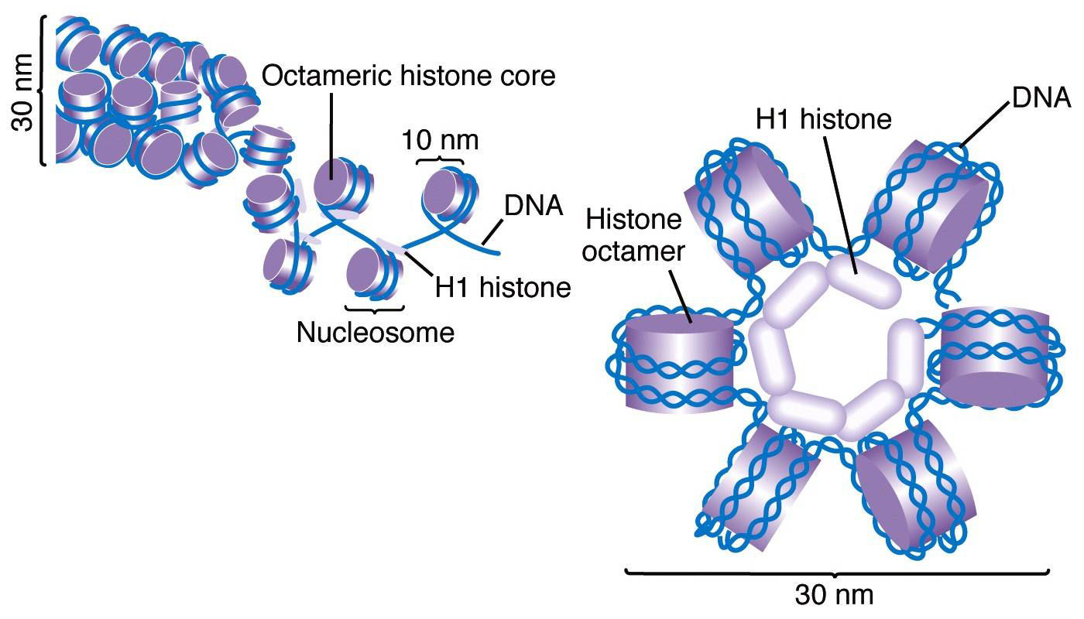
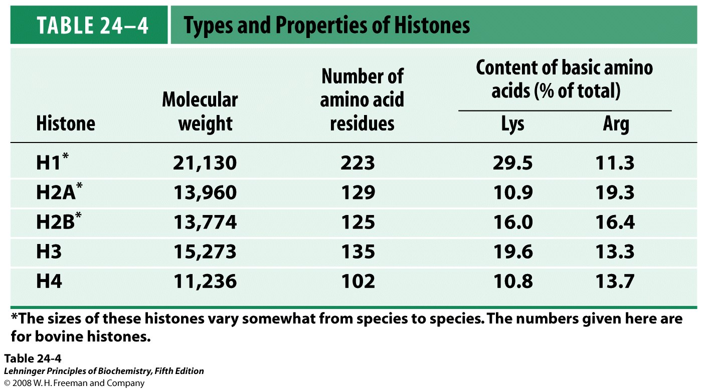
Histone binding to DNA

